Slide 1
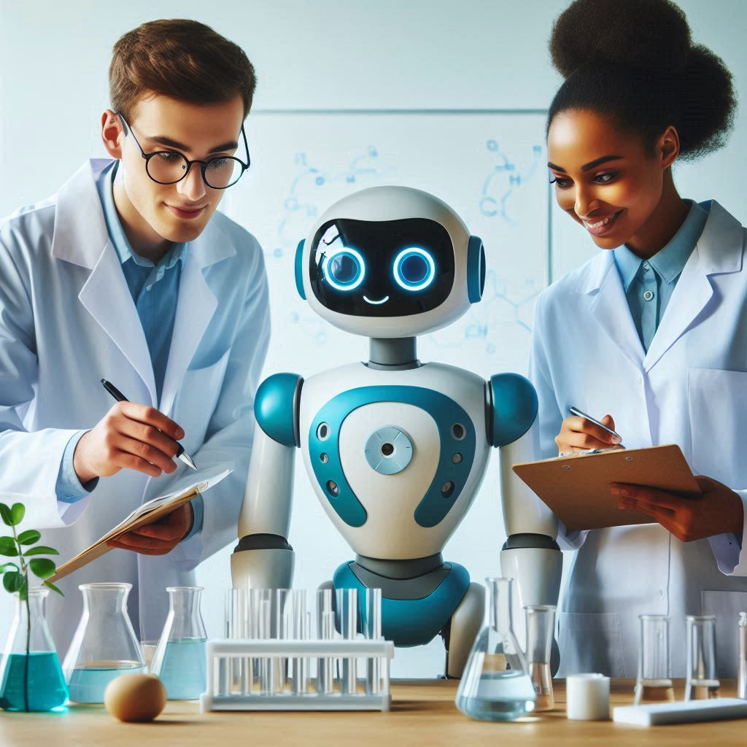
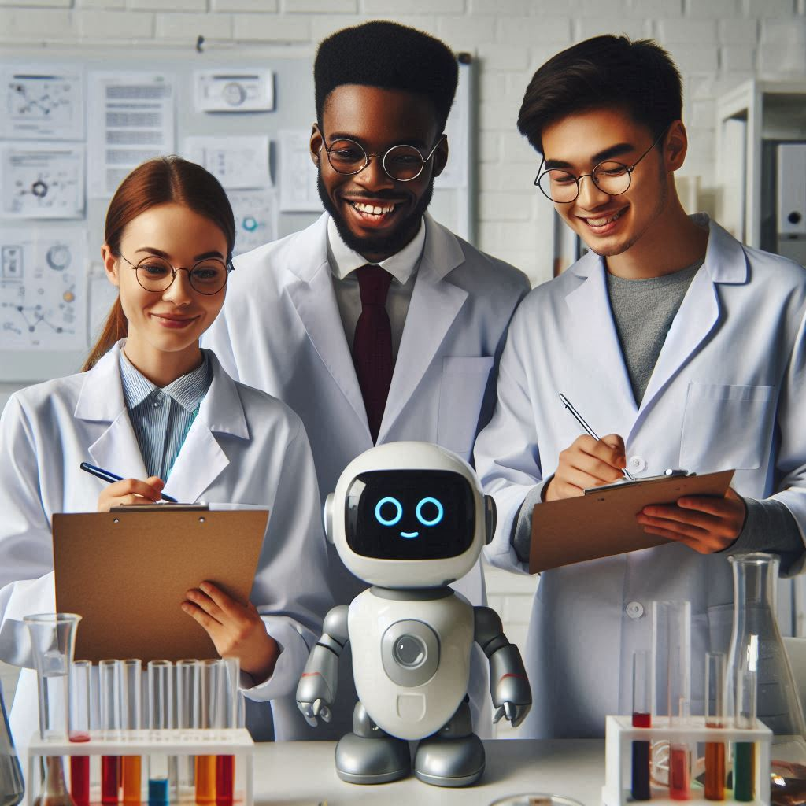
Generative AI
Gen AI Tools

Slide 2
Gen AI Tools

Slide 3
Academic Papers databases
semanticscholar.org
openread.academy
https://consensus.app/search/

Slide 4
Review Literature / AI Search Engines
Explain Paper
Perplexity AI
SCISPACE
Elicit
Paperbrain
tavily.com

Slide 5
Concept Mind Maps
heuristi.ca

Slide 6
Image Generation
ideogram.ai
canva.com
openart.ai
https://leonardo.ai/

Slide 7
Alternatives to GPT
claude.ai

Slide 8
Review tools / writing assitance
Quillbot
jenni.ai
semihuman.ai
paperpal.com

Slide 9
Talk to your data
powerdrill.ai
www.chatdb.ai

Slide 10
ideation and decision-making
jeda.ai

Slide 11
Video Generation Tools
Tools
haiper.ai
ai.invideo.io
Filmora AI

Slide 12
Tools summary / comparison
https://guides.library.georgetown.edu/ai/tools
https://huit.harvard.edu/ai/tools

Slide 13
Best AI Video Generators for 2024
https://invideo.io/blog/best-ai-video-generators/
Invideo AI: Generating videos from text prompts
Descript: Script-based video editing
Runway: Exploring generative AI for text-based video creation
Fliki: Making videos tailored specifically for social media
Visla: Making scripts into videos
Opus Clip: Turning long-form videos into short-form content
Colossyan: Creating videos for workplace learning
DeepBrain AI: Turning text into videos
Hour One: Creating medium to short-form videos
Synthesia: Mixing in digital avatars

Slide 14
Image Generation
Tools
Shutterstock: Best AI Art for Any Project
DALL-E 2: The Game-Changer
Hotpot: The Best Portrait Artist
NightCafe: A Community at Your Fingertips
Deep Dream Generator: The Best for Surrealism

Slide 15
AI directories
https://www.stork.ai/
https://findmyaitool.com/
https://www.futurepedia.io/
https://www.aitoolhunt.com/
https://aitoolsdirectory.com/
https://www.theailibrary.co/directory

Slide 16
AI detector tools
https://ddiy.co/ai-image-detection-tools/
AI or Not aiornot.com
illuminarty.ai
https://huggingface.co/spaces/umm-maybe/AI-image-detector

Slide 17

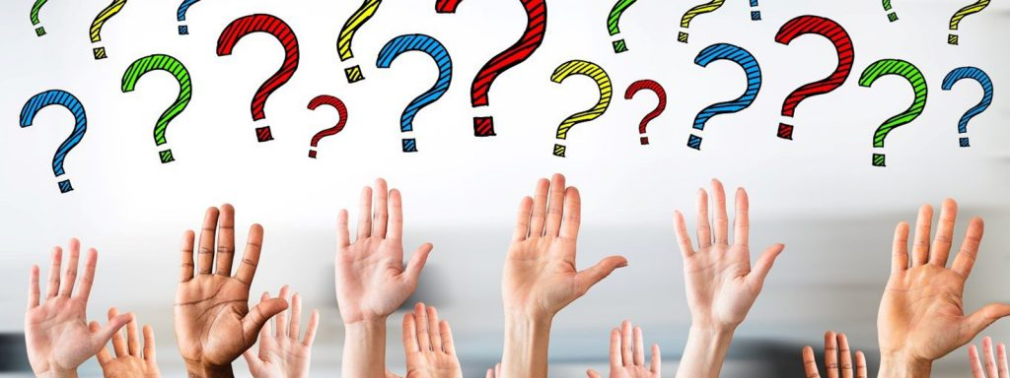
Q&A

